Slide 1
A general introduction to the Text Encoding Initiative (TEI)
Laurent Romary, Inria

Slide 2
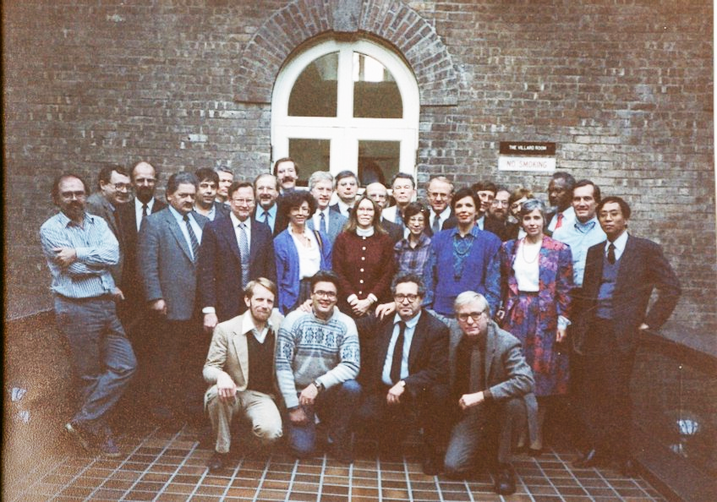
In the beginning
Humanities
Text archives
Standards
SGML
Michael Sperberg-McQuen
Lou Burnard
1. Novembre 1987: Vassar College, Poughkeepsie

Slide 3
TEI as a community endeavor
A trend towards digital curatorship
Describing digital sources: meta-data
Understanding and representing the structure of digital sources: content
Enriching (annotations, links), versioning, disseminating
A wide user community
From individual scholars to large digitization projects

Slide 4
TEI in a nutshell
TEI namespace:
xmlns="http://www.tei-c.org/ns/1.0"
TEI documentation:
http://www.tei-c.org/release/doc/tei-p5-doc/en/html/
TEI processor, Roma:
http://www.tei-c.org/Roma/
TEI document model
Read: http://www.tei-c.org/release/doc/tei-p5-doc/en/html/DS.html
TEI architecture: modules, classes
TEI vocabulary: more than 500 elements…
Read: http://www.tei-c.org/release/doc/tei-p5-doc/en/html/CO.html

Slide 5
TEI –core principles (1)
The TEI document as a digital surrogate of a physical source
A TEI document is always part of a digital library workflow
Source – surrogate – enrichment – publication
Recorded in the header; encoded in the content
Born digital documents may as well encounter a succession of changes/versions
The TEI document as an autonomous object in a DL workflow
Embedded meta-data + content
Multiple “hands”: annotation

Slide 6
TEI –core principles (2)
Favoring the semantics rather than the layout
(quasi) No presentational construct
Publication requires a transformation stage (XSLT; ePub, pdf, HTML, etc.)
Document structure
Macro-structure: front-body-back
Meso-structure: divisions, paragraphs/lists/figures/etc.
Micro-structure: in-line annotation mechanisms
Dates, names, notes, references, foreign expressions, etc.

Slide 7
TEI as a standardization body (1)
Consensus building
Community based decision process
Maintenance
Two releases per year
Publication
All TEI contents are available under the double CC-BY+BSD 2-clause license.

Slide 8
TEI as a standardization body (2)
Organization
Consortium of institutional and individual members
Conference, journal (jTEI)
The TEI at work
Board: administrative aspects
Technical council: coordinates the evolution of the TEI guidelines

Slide 9
Standardization work
Community based workflow
Mailing list
GitHub – bugs and features
Recording all issues and decisions
Cf. ODD as a specification platform
Deliverables
Documentation — TEI guidelines (584 elements as of 4.4.0)
Schemas — DTD, RelaxNG, W3C
Additional resources
Tools
Online customization: Roma
Online processing: OxGarage
Stylesheets (included in Oxygen)
Examples — TEI by Example

Slide 10
The TEI guidelines
Online documentation
Prose description organized in chapters
Specific documentation for each element
Access to all examples from the guidelines
Schema(s)
RelaxNG, W3C (, DTD)
Available online from the Roma interface
Delivered as packages (Ubuntu, Oxygen)
The TEI guidelines as specifications
Documentation and schemas are generated from one single specification file
Expressed in a TEI sub-language: ODD (One Document Does it all)

Slide 11
The central role of customization
Each TEI project starts with the definition of a customisation
Module selection
Sub-setting elements
Reducing possible values or content models
Adding, when necessary, new descriptive object
ODD as the technical platform for customization

Slide 12
Consequences
Family of formats
Comparison of two TEI-based projects through their ODDs
Support for third-party projects
(cf. PDM) in-house maintenance of customization and documentation
Does not prevent one from knowing the TEI components…
Most project can live with just a subset of the TEI ontology
With the strong possibility to impact on the guidelines themselves
E.g. <abstract>

Slide 13
Components of a TEI document
Part 2

Slide 14
TEI document architecture
<TEI>
<TEIHeader>
<text>
{additional components}
<front>
<body>
<back>

Slide 15
An essential component: the header
Every TEI-conformant document comprises a header usually followed by a text
the header contains:
mandatory file description (<fileDesc>)
optional encoding (<encodingDesc>), profile (<profileDesc>) and revision (<revisionDesc>) descriptions
the header is essential for:
bibliographic control and identification
resource documentation and processing

Slide 16
The components of a TEI header
<teiHeader>
<fileDesc>
<profileDesc>
<revisionDesc>
<encodingDesc>
The title page of the document
Constraints and editorial choices
General characteristics of the content
Digital history of the document

Slide 17
The TEI header: <fileDesc>
Bibliographic description of the whole document
Main descriptors comprise:
Title and responsibilities associated to the document (<titleStmt>)
Details regarding the publication of the document (<publicationStmt>)
E.g. licensing
Information about the source(s) of the document (<sourceDesc>)

Slide 18
<fileDesc>: example
<teiHeader>
<fileDesc>
<titleStmt>
<title>Thomas Paine: Common sense, a machine-readable transcript</title>
<respStmt>
<resp>compiled by</resp>
<name>Jon K Adams</name>
</respStmt>
</titleStmt>
<publicationStmt>
<distributor>Oxford Text Archive</distributor>
</publicationStmt>
<sourceDesc>
<bibl>The complete writings of Thomas Paine, collected and edited by Phillip S. Foner (New York, Citadel Press, 1945)</bibl>
</sourceDesc>
</fileDesc>
</teiHeader>

Slide 19
A quick overview of the other header components
<encodingDesc>
Characters, elements, geo-references, editorial choices (sampling)
<profileDesc>
Index terms, abstract, classification codes, languages of the document, participants (who speaks, who writes, who annotates)
<revisionDesc>
<revisionDesc status="embargoed”>
<change when="1991-11-11" who="#LB"> deleted chapter 10</change>
</revisionDesc>

Slide 20
Basic structure of a TEI text
A TEI text has a little more structure: it contains
optional front matter (<front>)
Title page, table of contents, preface
a body (<body>)
Main informational content of a document
optional back matter (<back>)
Index, bibliographic references

Slide 21
The body of a text usually has divisions
<div>’s may be nested within one-another
Systematic usage of “global attributes”
the type attribute labels a particular level e.g. as "part" or "chapter“
the n attribute gives a particular division a name or number
the xml:id attribute gives a particular division a unique identifier

Slide 22
For example...
<text>
<front>
<!-- titlepage, etc here -->
</front>
<body>
<div type="book" n="I" xml:id="JA0100">
<head>Book I.</head>
<div type="chapter" n="1" xml:id="JA0101">
<head>Of writing lives in general...</head>
<!-- remainder of chapter 1 here -->
</div>
<div n="2" xml:id="JA0102">
<!-- chapter 2 here -->
</div>
<!-- remainder of book 1 here -->
</div>
<div type="book" n="II" xml:id="JA0200">
<!-- book 2 here -->
</div>
<!-- remaining books here -->
</body>
</text>

Slide 23
Text components
Paragraph level components:
Paragraphs: <p>
Tables: <table>
Figures: <figure>
Groups of lines: <lg>/<l>
Lists of items: <list>/<item>
Speech turns: <u>
Drama turn: <sp>
These may be mixed, and may also appear directly within undivided texts

Slide 24
Example: Encoding a list
<list type="xmas">
<label>For my true love</label>
<item>
<list type="bullets">
<item>three calling birds></item>
<item>two french hens</item>
<item>a partridge in a pear tree</item>
</list>
</item>
<label>For Uncle Joe</label>
<item>socks as usual</item>
</list>

Slide 25
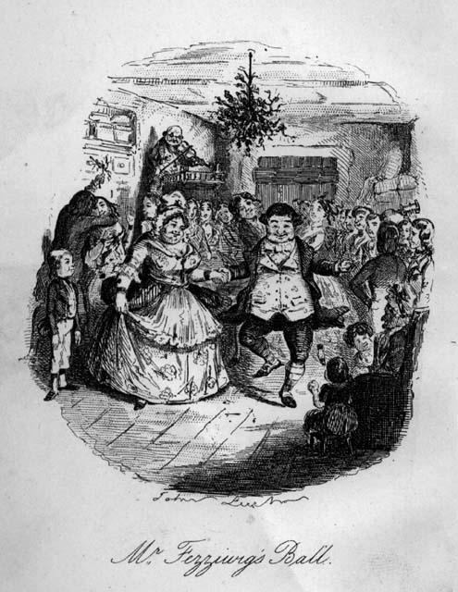
Example: Encoding illustrations
<figure>
<head>Mr Fezziwig's Ball</head>
<figDesc>A Cruikshank engraving showing Mr Fezziwig leading a group of revellers.</figDesc>
<graphic url="fezz.gif"/>
</figure>

Slide 26
Inline markup
phrases that are conventionally typographically distinct
Highlighting (<hi>, <emph>, <mentioned>)
“data-like” (names, numbers, dates, times, addresses)
Cf. chapter “Names, Dates, People, and Places”
editorial interventions (corrections, regularizations, additions, omissions ...)
cross references and links

Slide 27
Example: Inline annotations
<head>Of writing lives in general, and particularly of Pamela, with a word by the bye of <name ref="#CIBC03">Colley Cibber</name> and others.</head>
<p>It is a trite but true observation, that <q>examples work more forcibly on the mind than precepts</q>
</p>
<p> <name ref="#JA">Mr. Joseph Andrews</name>, <rs ref="#JA">the hero of our ensuing history</rs>, was esteemed to be ...</p>

Slide 28
Foreign language phrases
The xml:lang attribute may be attached to any element
<foreign> to mark up specific sequences in another language
Use the ISO 639 codes to identify language + BCP 47
Have you read <title xml:lang="de">Die Dreigroschenoper</title>?
<mentioned xml:lang="fr">Savoir-faire</mentioned> is French for know-how.
John has real <foreign xml:lang="fr">savoir-faire</foreign>.

Slide 29
Dealing with variety – bibliographies
Three main bibliographical objects
<bibl>
<biblStruct>
Covers a whole range of use cases (cf. PDM)
<biblFull>
A common descriptive vocabulary
model.imprintPart
<biblScope>, <distributor>, <pubPlace>, <publisher>
model.respLike
<author>, <editor>, <funder>, <meeting>, <principal>, <respStmt>, <sponsor>
<citedRange>, <edition>, <extent>, <listRelation>, <msIdentifier>, <relatedItem>, <relationGrp>, <series>, <textLang>

Slide 30
The <biblStruct> element
<biblStruct>
<analytic>
<monogr>
<series>
<imprint>

Slide 31
<biblStruct> - example
<biblStruct type="incollection">
<analytic>
<author>
<forename>Pliny Earle</forename>
<surname>Goddard</surname>
</author>
<title type="main" level="a">Athapascan (Hupa)</title>
</analytic>
<monogr>
<editor>Boas, Franz</editor>
<title type="main" level="m">Handbook of American Indian Languages</title>
<imprint>
<pubPlace>Washington, D. C.</pubPlace>
<publisher>Government Printing Office</publisher>
<date>1911</date>
<biblScope type="pp">85-158</biblScope>
</imprint>
</monogr>
</biblStruct>
Source: http://wals.info

Slide 32
Relation to existing standards
Default policy
Compliance to W3C and ISO standards
W3C: XML compliance, XML attributes (xml:id, xml:lang, xml:base)
ISO: ISO 10646/Unicode ISO 639/BCP 47 (languages), ISO 3166 (countries), ISO 8601 (times and dates)
Reuse of existing vocabulary
E.g. SVG, MathML

Slide 33
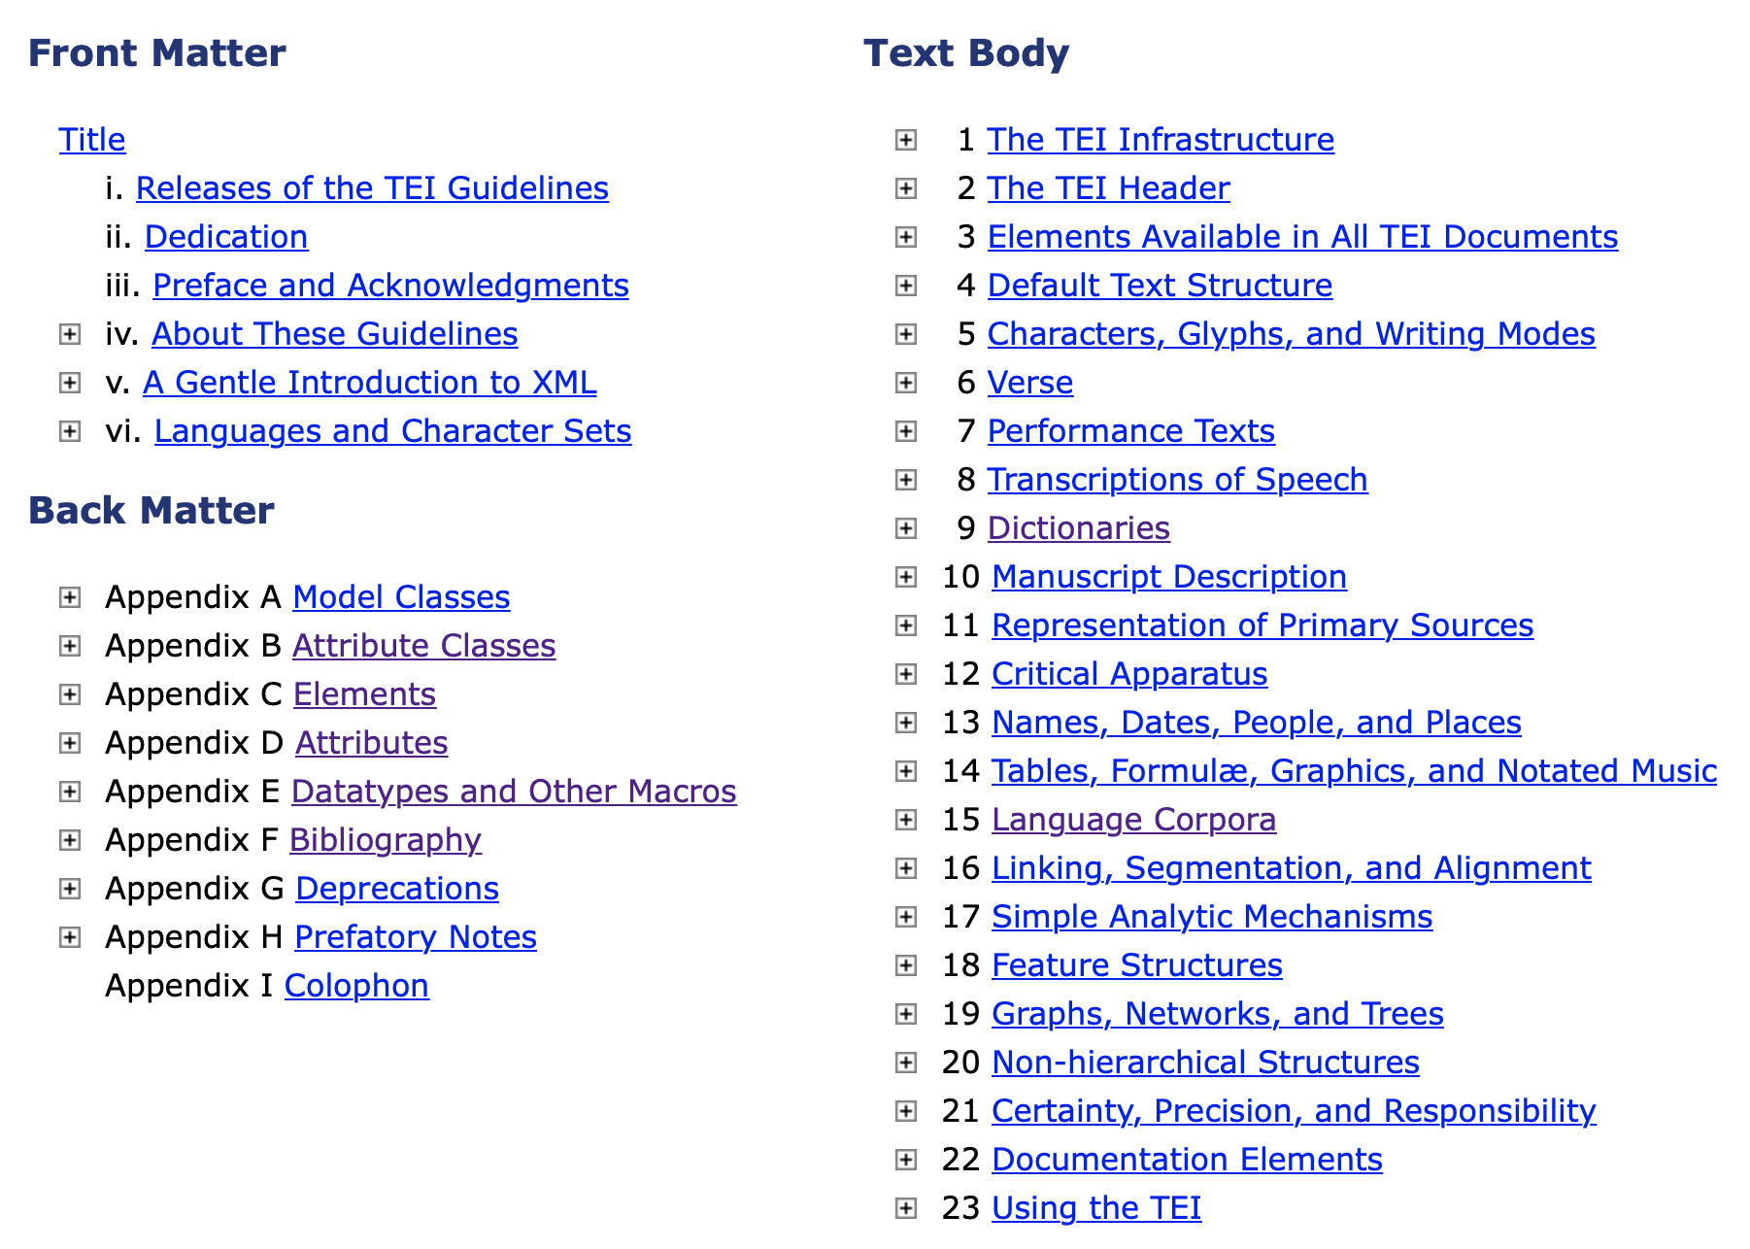
Your future trip?

Slide 34
Cast off all lines!
A glimpse in TEI customisation: https://roma.tei-c.org

